Slide 1
Introduction of Spring and Spring Boot

Slide 2
History:
It was developed by Rod Johnson in 2003.
It provides support to many other frameworks such as Hibernate, EJB, Struts, etc,
It is also called a framework of frameworks.
Spring:
It is a lightweight and popular open-source Java-based framework.
It provide comprehensive programming ( join all related items) and configuration model(combine JAR files) for modern java based Enterprise application.
It works on any kind of platform.
Why spring ?
It is secured, low-cost and flexible framework.
It improves coding efficiency and reduces overall application development time because it is lightweight.
It is efficient at utilizing system resources and has a lot of support.
It removes tedious configuration work so that developers can focus on writing business logic.
It handles the infrastructure so developers can focus on the application.

Slide 3
Spring boot:
Spring boot is not a framework, it’s a tool or extension to create Spring based applications.
It is a tool introduced by Spring Team.
It is used to create stand alone, production grade, quickly and easily spring based application that you can “Just Run”.
Concentrate only on the actual business logic rather than concentrating on the configuration.
Advantage of spring framework:
Predefined Templates:
It provides templates for JDBC, Hibernate, JPA etc. technologies.
So there is no need to write too much code.
Easy to Test:
The Dependency Injection makes easier to test the application.
The EJB or Struts application require server to run the application but Spring framework doesn't require server.

Slide 4
Loose coupling:
The Spring applications are loosely coupled because of dependency injection.
Lightweight:
Spring framework is lightweight because of its POJO implementation.
It doesn't force the programmer to inherit any class or implement any interface.
That is why it is said non-invasive.
Fast development:
The Dependency Injection feature of Spring Framework and it support to various frameworks makes the easy development of JavaEE application.
Powerful abstraction:
It provides powerful abstraction to JavaEE specifications such as JDBC,JPA
Declarative support:
It provides declarative support for caching, validation, transactions and formatting.

Slide 5
Difference between Spring and Spring Boot
Spring | Spring Boot
Spring is an open-source lightweight framework widely used to develop enterprise applications. | Spring Boot is built on top of the conventional spring framework, widely used to develop REST APIs.
The most important feature of the Spring Framework is dependency injection. | The most important feature of the Spring Boot is Autoconfiguration.
It helps to create a loosely coupled application. | It helps to create a stand-alone application.
To run the Spring application, we need to set the server explicitly. | Spring Boot provides embedded servers such as Tomcat and Jetty etc.
To run the Spring application, a deployment descriptor is required. | There is no requirement for a deployment descriptor.

Slide 6
To create a Spring application, the developers write lots of code. | It reduces the lines of code.
It doesn’t provide support for the in-memory database. | It provides support for the in-memory database such as H2.
Developers need to write boilerplate code for smaller tasks. | In Spring Boot, there is reduction in boilerplate code.
Developers have to define dependencies manually in the pom.xml file. | pom.xml file internally handles the required dependencies.

Slide 7
Spring Boot Architecture:
Spring Boot is a module of the Spring Framework.
It is used to create stand-alone, production-grade Spring Based Applications with minimum efforts.
It is developed on top of the core Spring Framework.
It follows a layered architecture, each layer communicates to other layers.
Why Spring Boot ?
The main aim of spring boot is to remove the XML and annotations-based configuration settings from the application.
Along with it provides benefits such as opinionated(options to later change the configuration), convention over configuration, stand-alone, and production-ready.
It has four layers. They are,
Presentation Layer
Business Layer
Persistence Layer
Database Layer

Slide 8
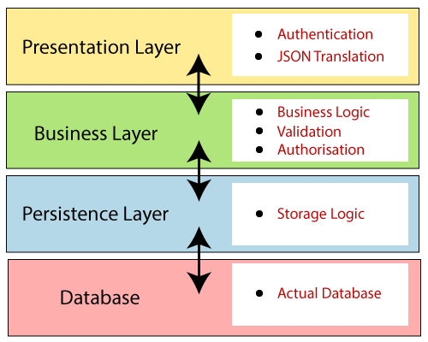

Slide 9
Presentation Layer:
The presentation layer is the top layer of the spring boot architecture.
It consists of Views. i.e., the front-end part of the application.
This layer handles the HTTP requests, translates the JSON parameter to java object, and authenticates the request and transfer it to the business layer.
Business Layer:
The business layer contains all the business logic.
It consists of services classes.
It is responsible for validation and authorization.
Persistence Layer:
The persistence layer contains all the storage logic.
It translates business objects from and to database rows.
Database Layer:
The database layer contains all the databases such as MySql, MongoDB, etc.
It is responsible for performing the CRUD (create, retrieve, update, delete) operations.

Slide 10
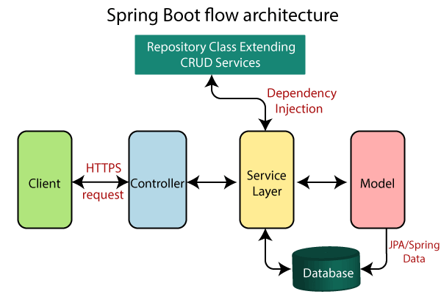

Slide 11
Explanation:
Creates a data access layer and performs CRUD operation.
The Client makes an HTTP request(GET, PUT, POST, etc.)
The request goes to the controller, and the controller maps that request and handles it. After that, it calls the service logic if required.
The business logic is performed in the Service layer. The spring boot performs all the logic over the data of the database which is mapped to the spring boot model class through JPA (Java Persistence Library).
The JSP page is returned as Response from the controller or no error occurred.

Slide 12
Presentation Layer - controller package
Business Logic Layer - service package
Data Access Layer - repository package
Persistence layer -use the JPARepository Interface
Presentation layer is the equivalent of the Controller class. The Controller class handles all the incoming REST API requests (GET, POST, PUT, DELETE, PATCH) from the Client.
Business layer is the equivalent to the Service class. It handle the business logic.
The Business layer communicates with both the Presentation layer and the Persistence Layer.
Persistence layer is the equivalent of the Repository interface. We write database queries inside this interface.
This layer is the only layer that communicates with the Business layer and the Database layer.
This layer is simply the actual database that you decide to use to build your application.

Slide 13
Monolithic architecture:
It is a traditional approach of building web applications, design software.
All the components are packaged together into a single unit.
( or )
An entire application is built as a single,
It use tightly coupling.
Ex:
Spring Boot Application
It contain user interface, business logic and data access layer. That all are built in single unit. If error occur in any one of the layer, the entire application show error. So it is hard to find where the error is occurred.
Microservices overcome this problem using loosely coupled services.

Slide 14
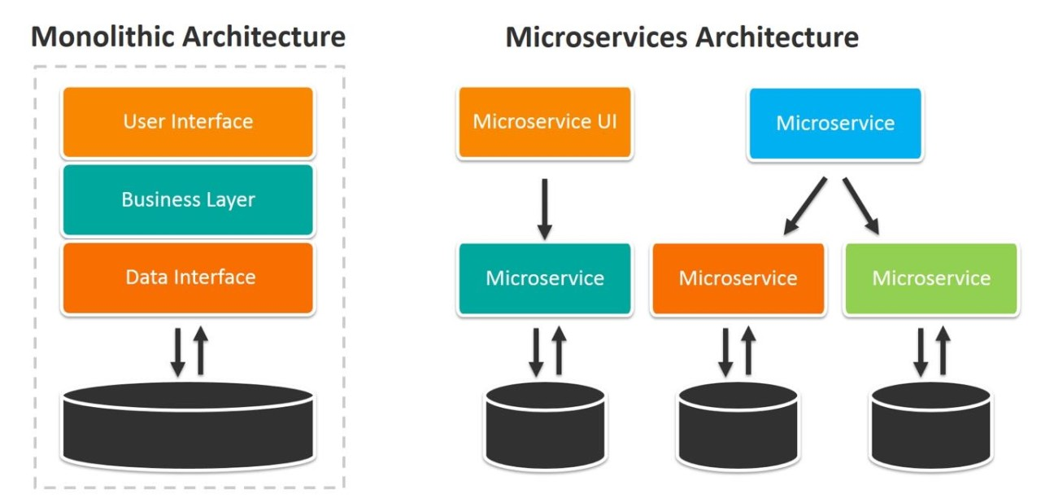

Slide 15
Microservices:
Microservices are an architectural approach to develop software applications as a collection of small, independent services that communicate with each other over a network.
It use loosely coupling.
It work by breaking down a complex application into smaller, independent pieces that communicate and work together.
Tight coupling:
When two classes are highly dependent on each other, it is called tight coupling.
A change in one class requires changes in the other class.
Loose coupling:
The classes are independent of each other is called loose coupling.
Dependency Injection:
It is a programming design pattern that makes code loosely coupled, meaning that any change in the application of one, will not affect the other.

Slide 16
IOC container :
IoC container is a framework for implementing automated dependency injection.
It contains object creation for the longer ways to use and injects dependencies within the class.
Bean :
It is an object that is managed by the Spring IoC (Inversion of Control) container.
It is typically used to represent components and services within a Spring application.
It is backbone of an application.

Slide 17
It creates so many files and folders. Let’s discuss these one by one in detail
src/main/java:
Contains the java source code. It contains the base package by default. The base package contains the base class with main() method.
in.bushansirgur.springbootapp: This is the base package which is created by spring initializer. The package name is given at the time creating the project.
SpringbootappApplication.java: This is the base class, which contains the main() method with @SpringBootApplication annotation. This is the starting point to our spring boot application.

Slide 18
package in.bushansirgur.springbootapp;
import org.springframework.boot.SpringApplication;
import org.springframework.boot.autoconfigure.SpringBootApplication;
@SpringBootApplication
public class SpringbootappApplication {
public static void main(String[] args) {
SpringApplication.run(SpringbootappApplication.class, args);
}
}

Slide 19
src/main/resources: It contains static folder, templates folder and property file.
static: This folder contains the static files such as html, javascript, css files. If we are creating the spring boot web application then this folder may contain the static files.
templates: This folder contains the templates for our application. For example, if we are creating web application, if we use thymeleaf template engine then this folder contains all the UI templates.
src/test/java: It contains the java source files for Unit testing. This also contains the base package and base class for Unit testing.
JRE System library: This contains the JDK and JRE system related jars.
Maven Dependencies: This contains the dependency jars for our application.

Slide 20
src: This folder is same as the src/main/java
target: This folder contains the war/jar and build related files after the application is successfully build.
HELP.md: This file contains the reference links for spring boot and apache tomcat
mvnw: These are the Maven wrapper files, which allows us to run the maven project on Linux/mac
mvnw.cmd: This is also Maven wrapper files, which allows us to run the maven project on Windows platform
pom.xml: It contains the project related information and dependencies used in the application.

